Slide 1

TEAM 15
Anto P V
Vivek Mohan
V Yadhu krishnan

Slide 2

CLOUDCART?
With CloudCart, one can book items/services and also pay for those items sitting at home. Customers can choose the time slot during which they want to go and take their products from the shop, but only a limited amount of people can only book in a particular slot. This is done to reduce the rush and time that people are being outside.
2

Slide 3
Website Routes
1

Slide 4
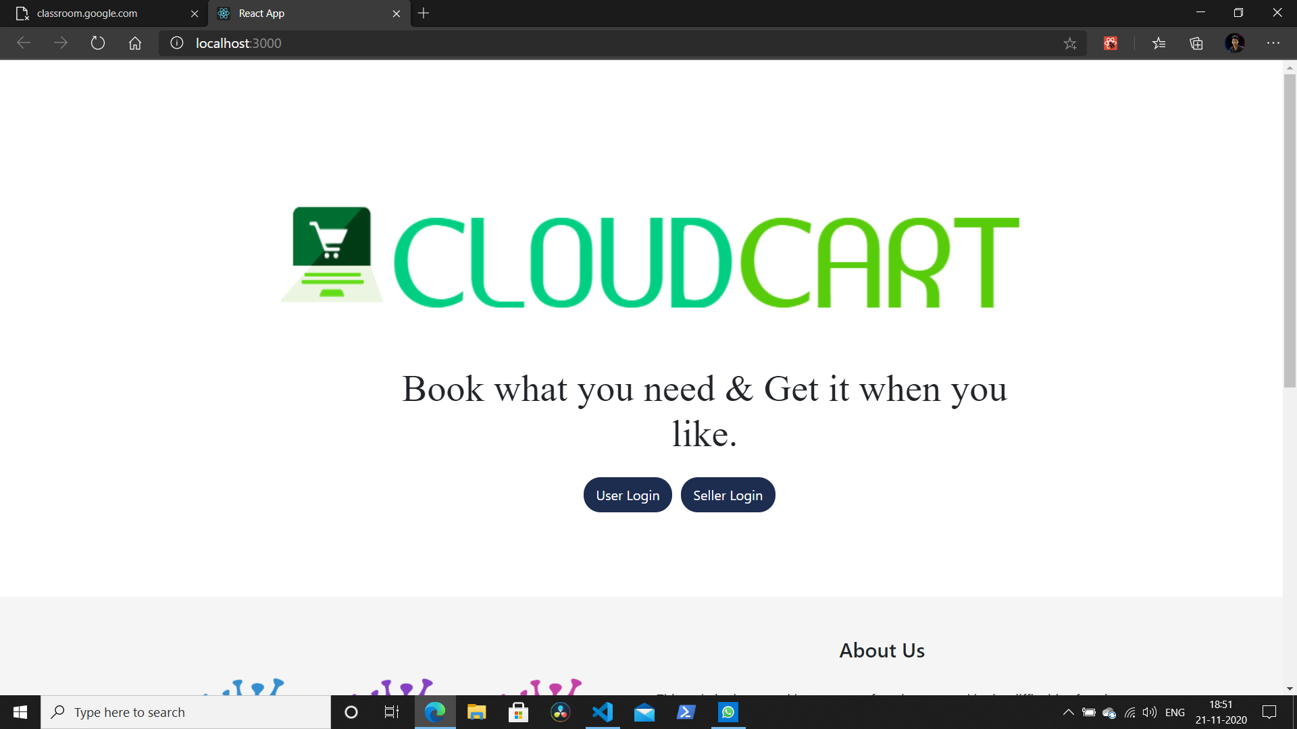
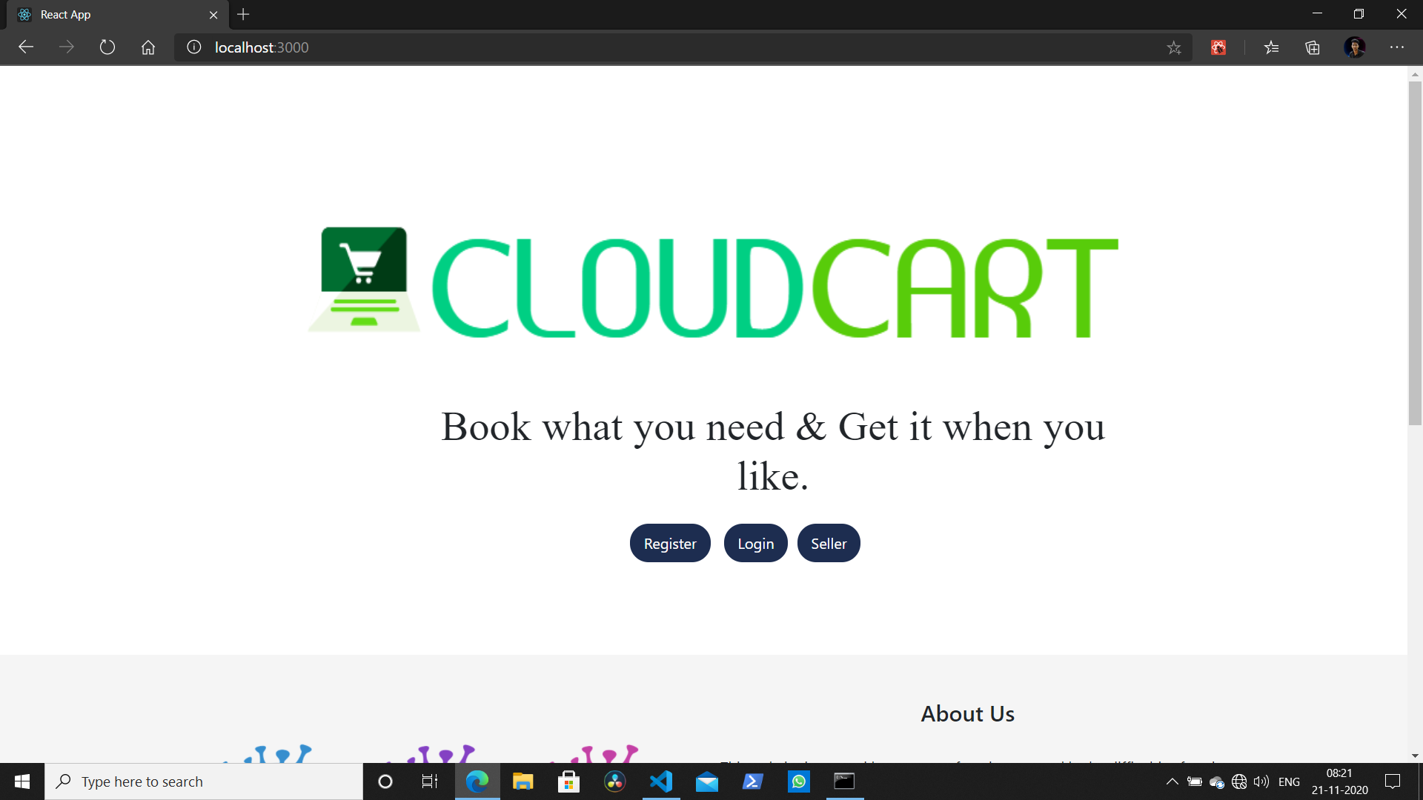
1

Slide 5
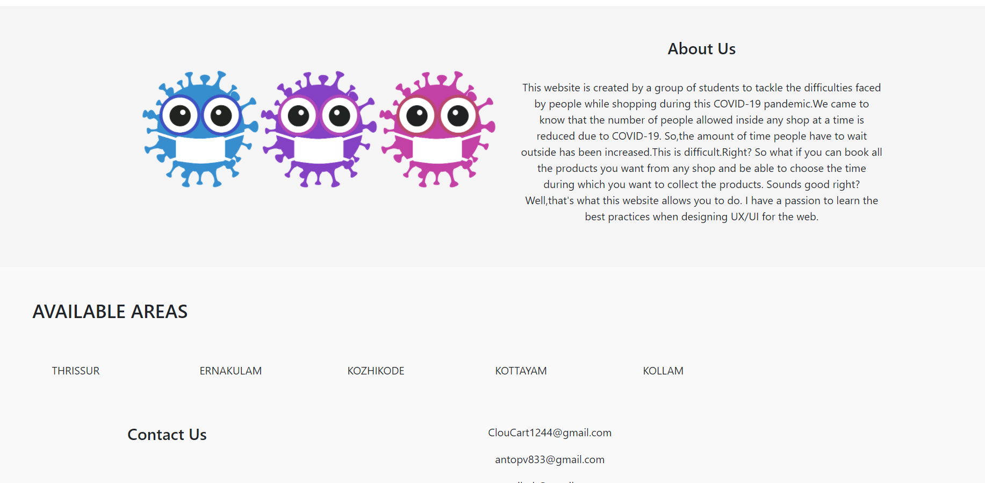
Flow Chart
1

Slide 6
Seller Routes

Slide 7
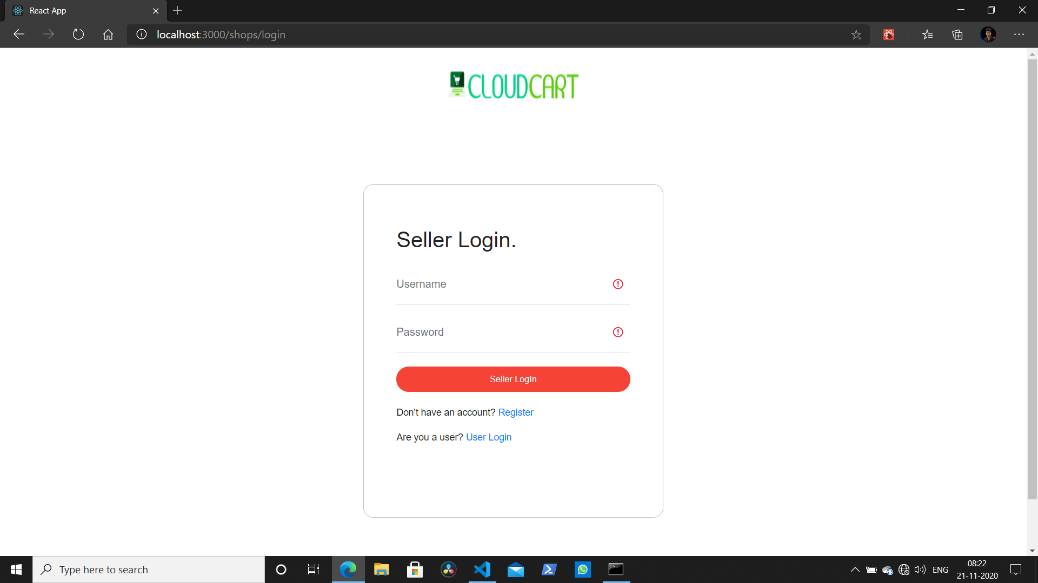
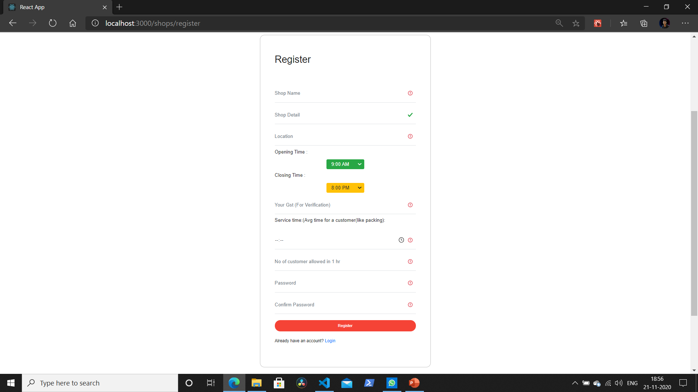
1

Slide 8
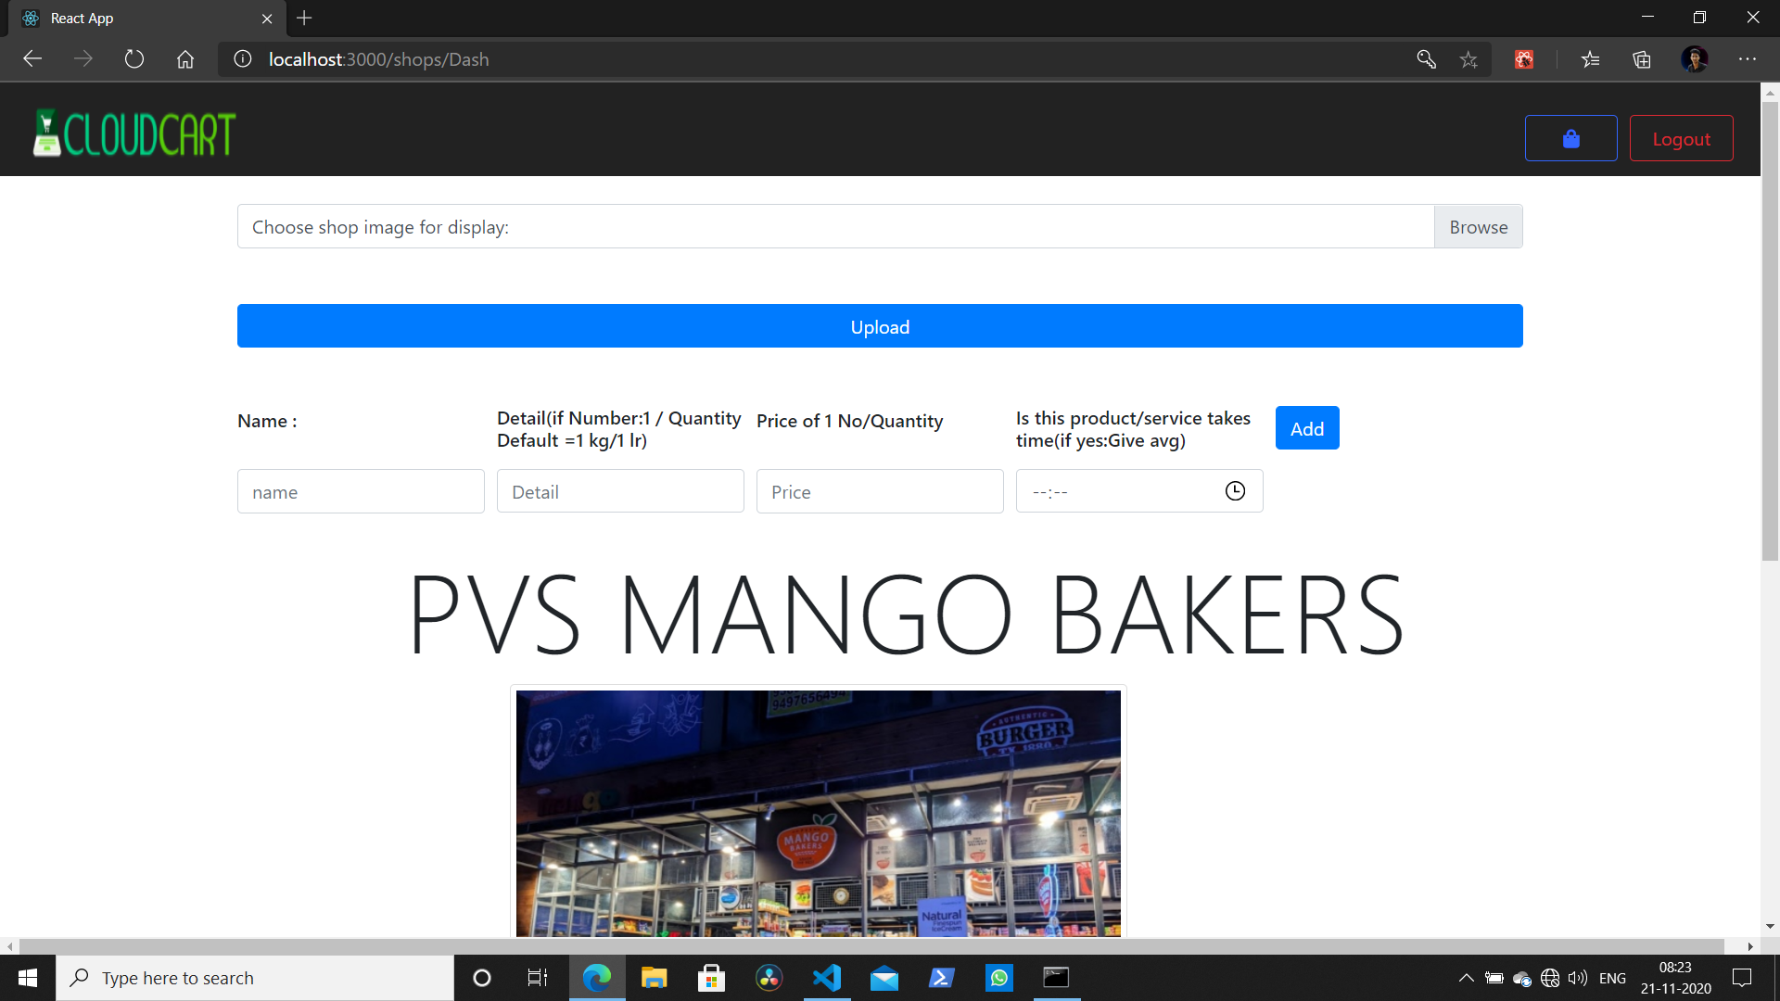
Flow Chart
1

Slide 9
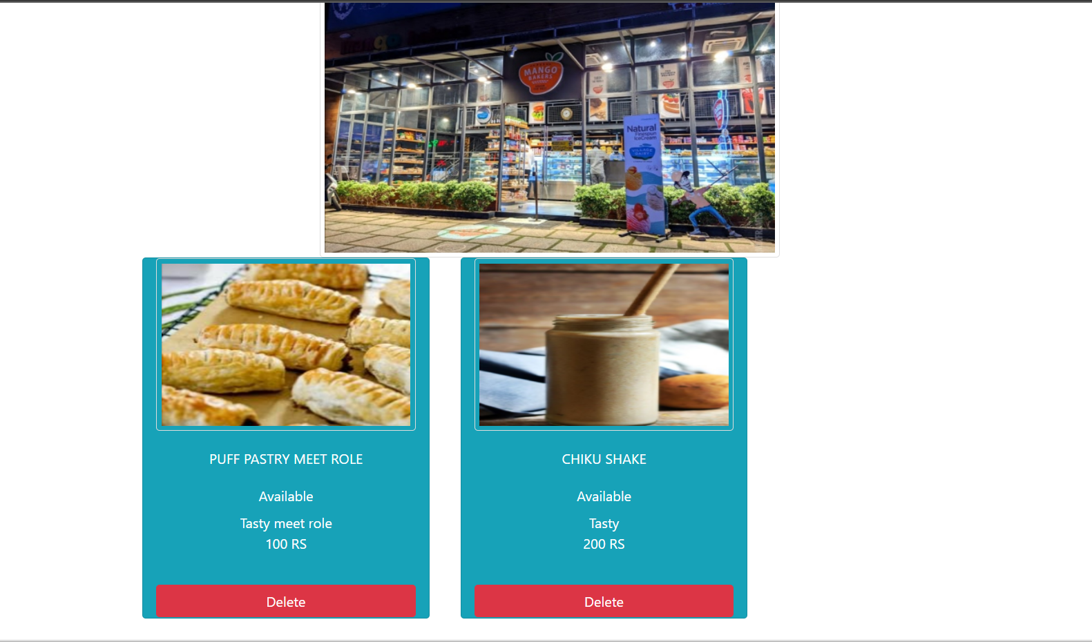
Flow Chart
1

Slide 10
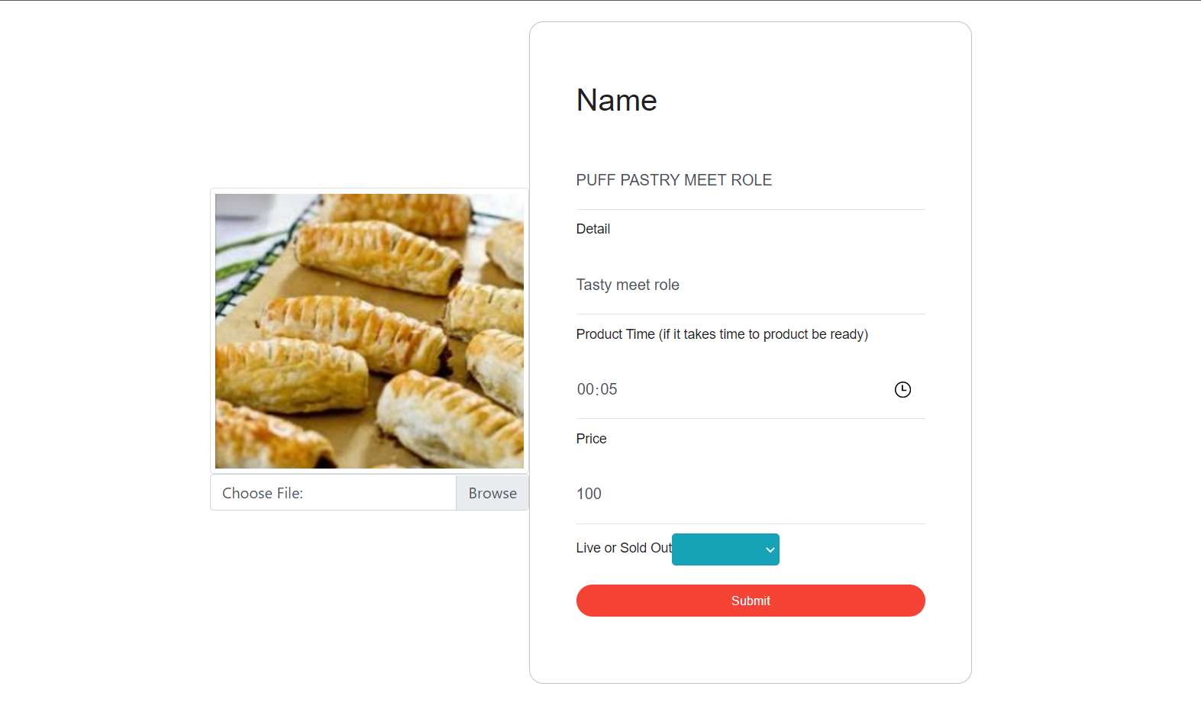
Flow Chart
1

Slide 11
User Routes

Slide 12
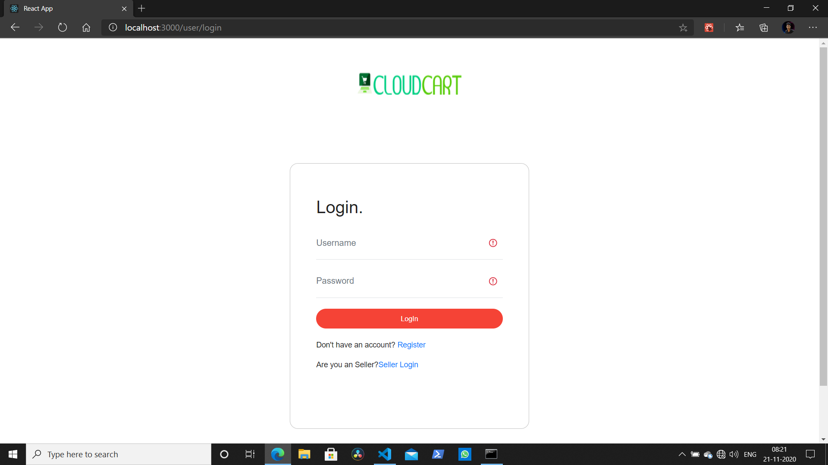
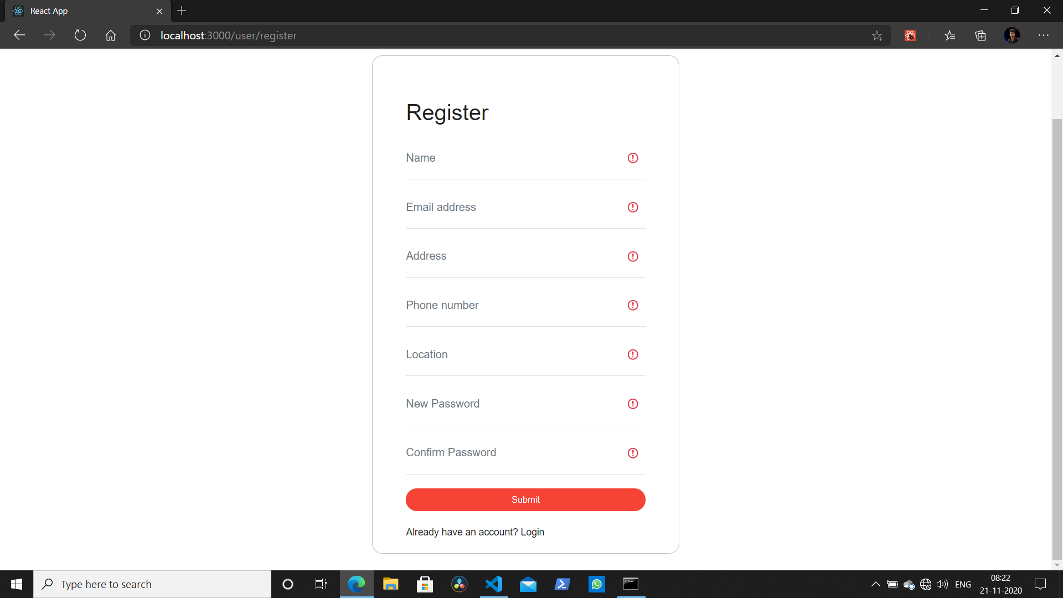
1

Slide 13
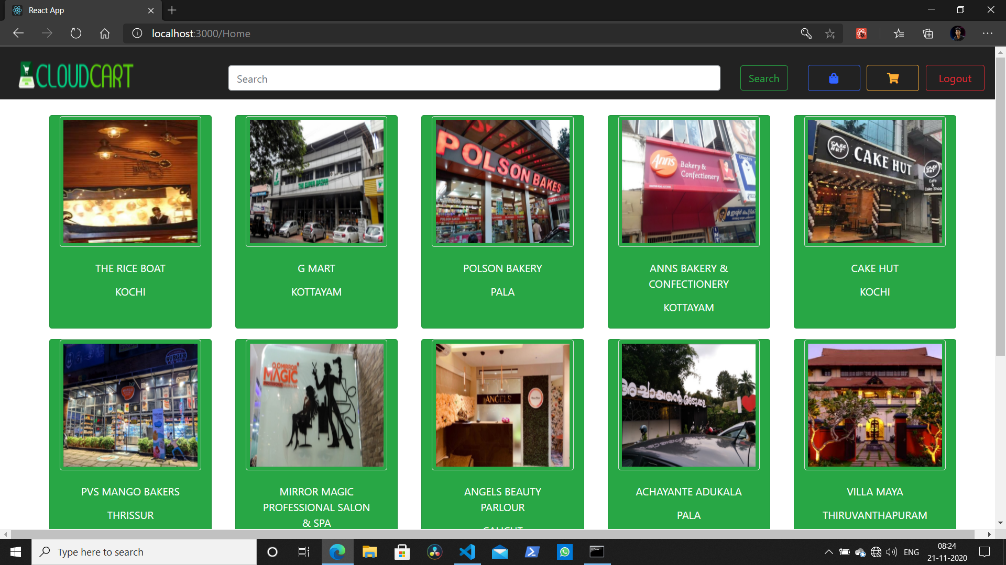
Flow Chart
1

Slide 14
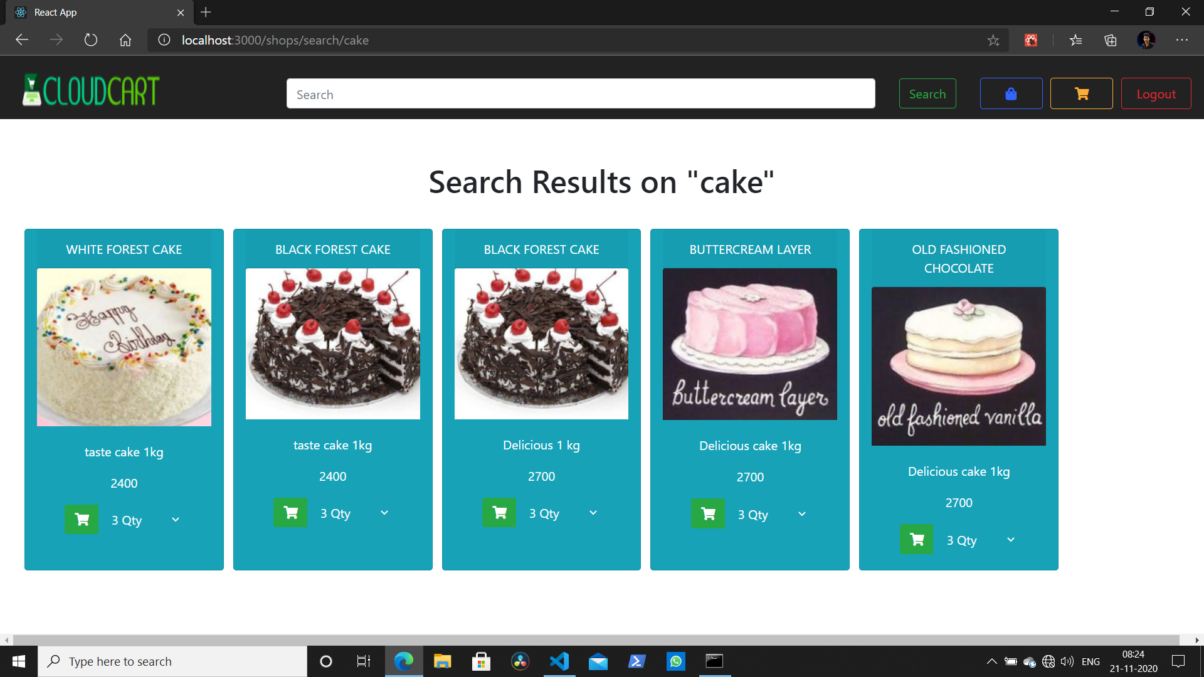
Flow Chart
1

Slide 15
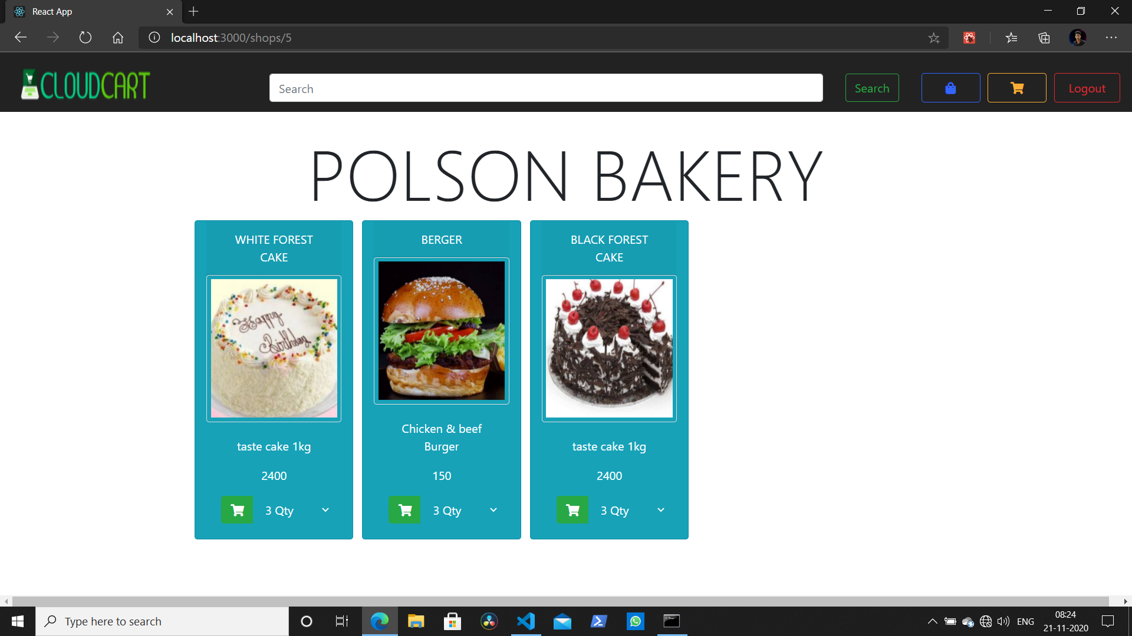
Flow Chart
1

Slide 16
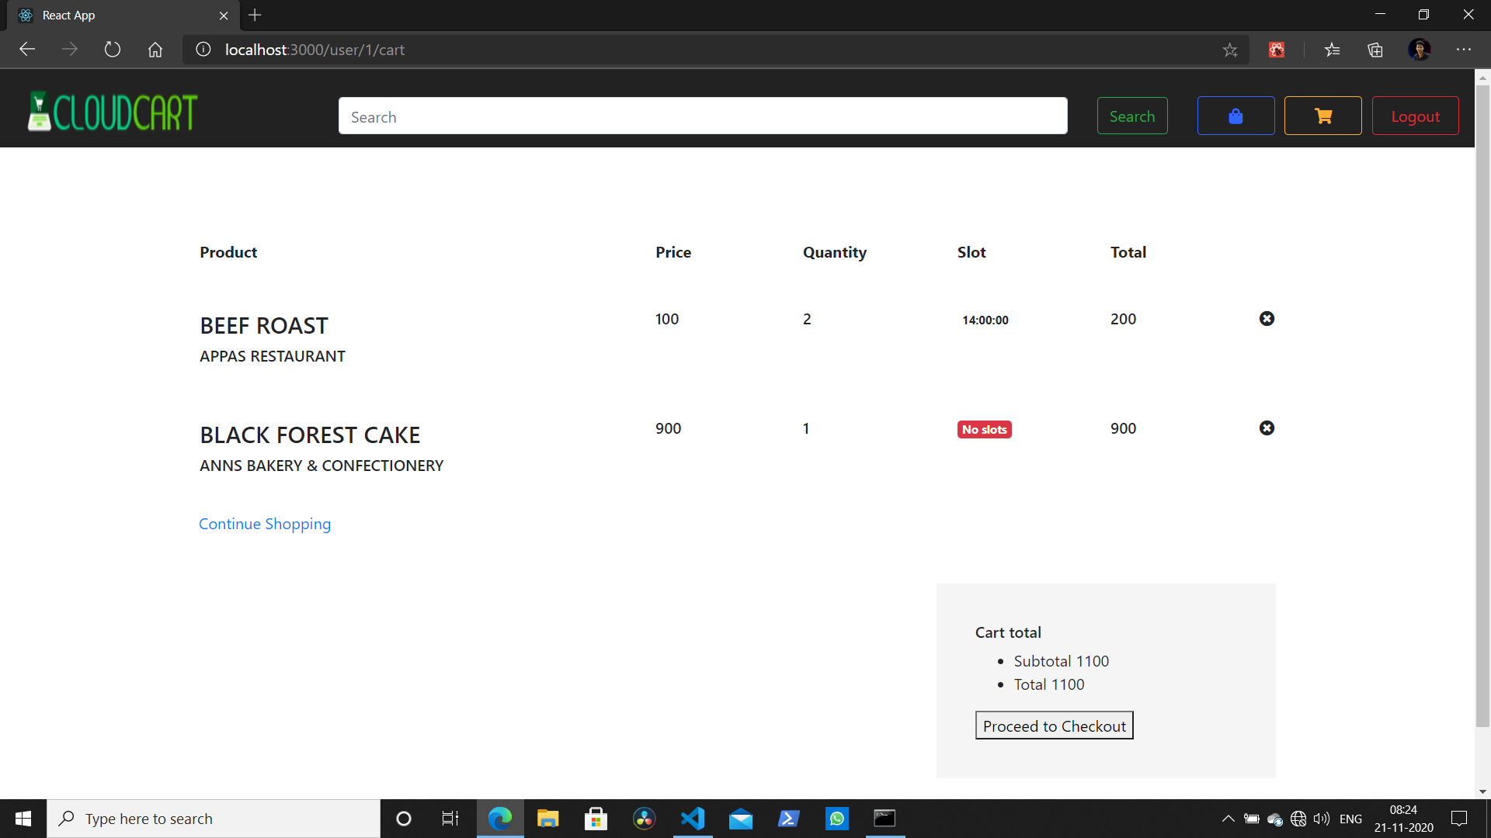
Flow Chart
1

Slide 17
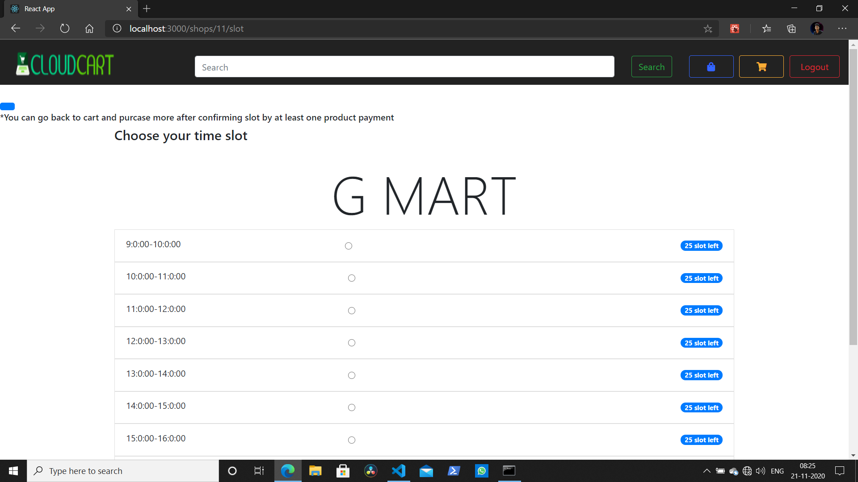
Flow Chart
1

Slide 18
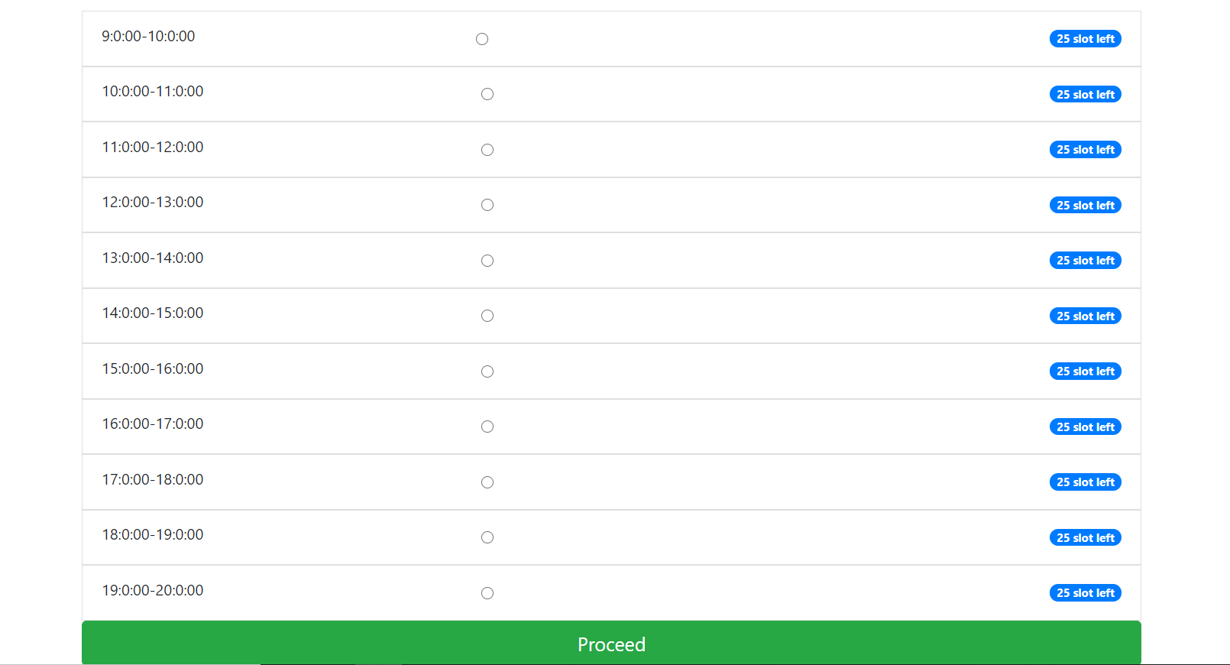
Flow Chart
1

Slide 19
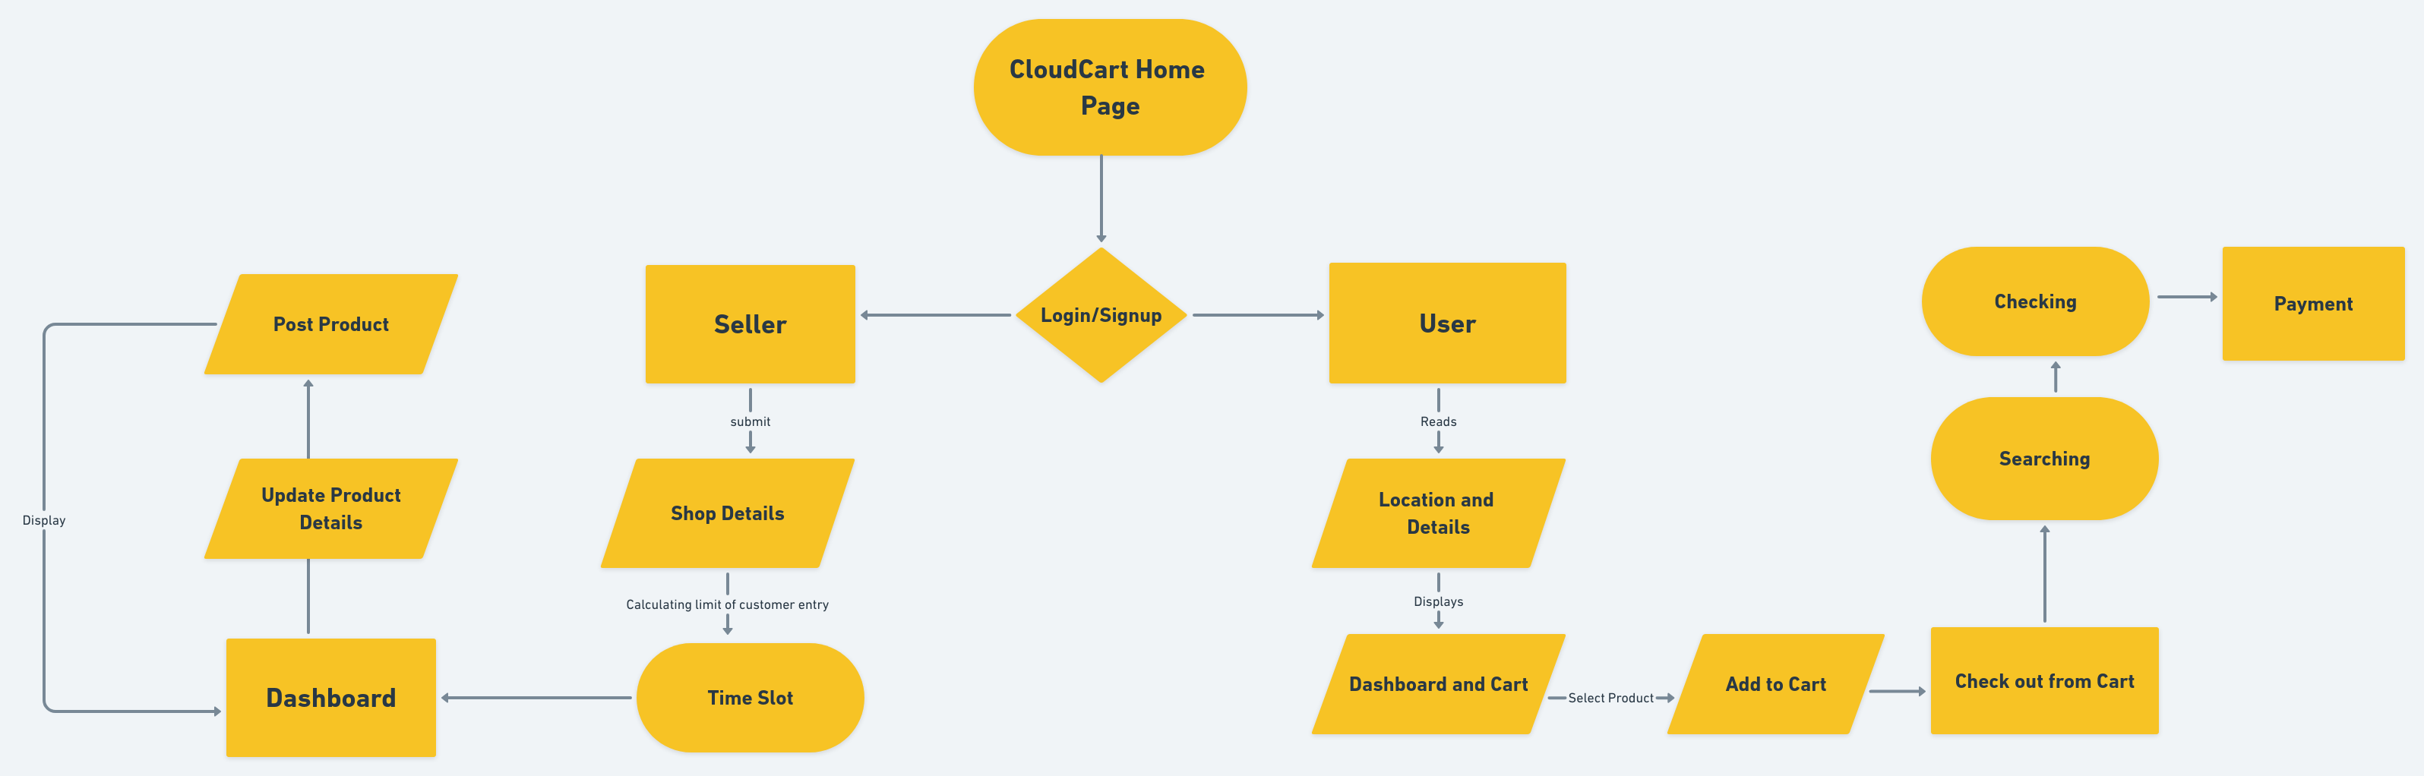

Slide 20
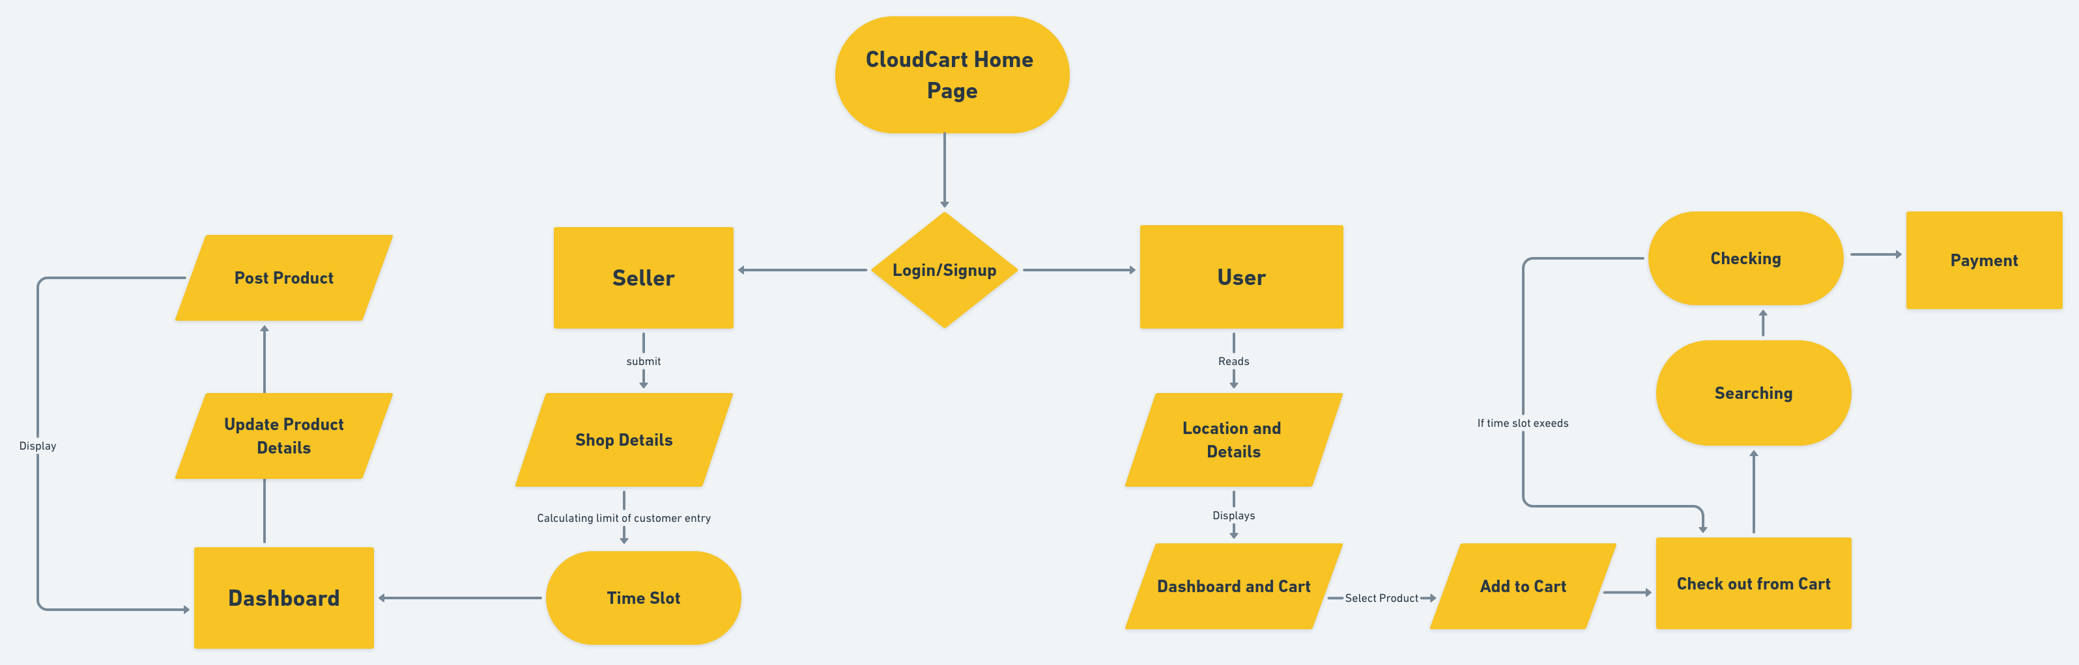

Slide 21
2
TABLES

Slide 22
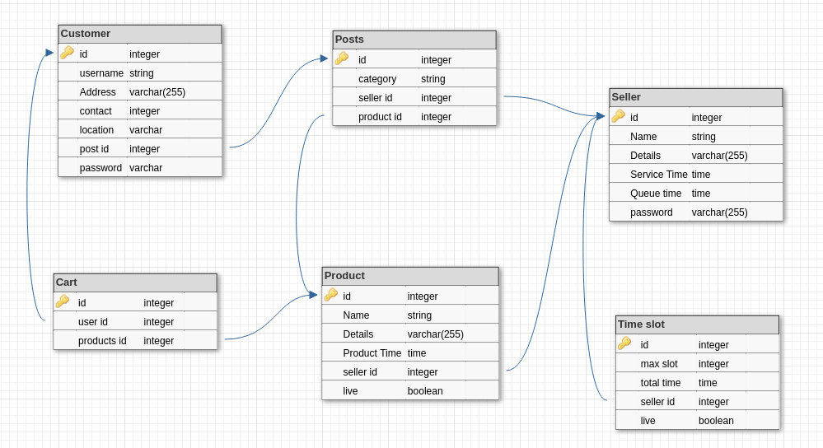
22

Slide 23
FUTURE ENHANCEMENTS :
We need to add better UPI payment section.
Providing direct messaging system with Seller.
User and Seller Authentication .
We would like to implement a rating option where users can rate the shop.
23

Slide 24
CONCLUSION :
We have created a website that allows the customers to order products from their local shops and also gave them the freedom to choose their preferred time slot(*if it is free) during which they want to collect their ordered products. This prevents users from standing in queue for the billing purposes(especially during this COVID-19 period).
24

Slide 25
THANK YOU
25

